Slide 1
IV Year B.Tech II Semester– Major Project Review
MOBILE FORENSIC ACTIVITY LOGGER
Team Members Details
D. Swathi 21N31A6219
D. Pavan Kumar 21N31A6221
K. Satya Venkat 21N31A6231
IV Year B. Tech II Semester – CSE (Cyber Security)
Under the Guidance of
J.Mahendar
Assistant Professor
Department of Emerging Technologies

Slide 2
Outline
Abstract
Introduction
Existing System
Proposed System
Difference between Existing and Proposed
Literature Review
Architectural Diagram
Technical Requirement Specification
Other System Diagrams
Test Cases
Status of the Project

Slide 3
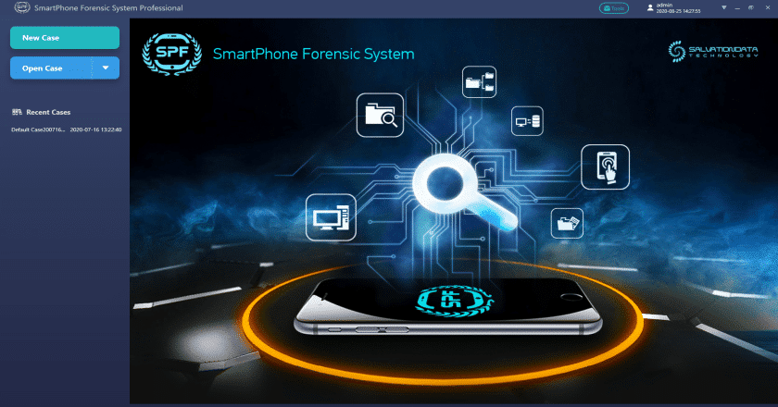
Abstract
Nowadays, mobile devices have become one of the most popular instruments used by a person onits regular life, mainly due to the importance of their applications.
In that context, mobile devices store user’s personal information and even more data, becoming a personal tracker for daily activities that provides important information about the user.
Derived from this gathering of information, many tools are available to use on mobile devices, with the restrain that each tool only provides isolated information about a specific application or activity.
Therefore, the present work proposes a tool that allows investigators to obtain a complete report and timeline of the activities that were performed on the device.
This report incorporates the information provided by many sources into a unique set of data.
Also, by means of an example, it is presented the operation of the solution, which shows the feasibility in the use of this tool and shows the way in which investigators have to apply the tool.

Slide 4
Introduction
Mobile devices store significant user behavior data, making them vital sources for forensic investigations.
Digital evidence includes deleted files, browsing history, messages, and login data, retrieved using specialized techniques that preserve the device's original state.
Forensic analysis requires avoiding evidence contamination, documenting processes methodically, and maintaining a controlled chain of custody.
Legal compliance is critical to prevent misuse of data and ensure adherence to jurisdictional guidelines.
A Python-based tool has been developed to generate unified reports of user activity on Android devices by aggregating data from various installed applications, addressing gaps in existing forensic solutions.

Slide 5
Existing System
Mobile devices are widely used in daily life due to the utility and importance of their diverse applications.
These devices act as personal trackers, storing vast amounts of personal and behavioral data about users.
They capture information related to daily activities, including app usage, communication, and browsing behavior.
Several forensic tools are available to analyze data stored on mobile devices.
Each tool focuses on isolated aspects, such as specific applications or activities, rather than providing a comprehensive view.
This fragmented approach limits the ability to analyze all relevant user data in one place.

Slide 6
Proposed System
The present project proposes a tool that allows investigators to obtain a complete report and timeline of the activities that were performed on the device.
This report incorporates the information provided by many sources into a unique set of data.
Also, by means of an example, it is presented the operation of the solution, which shows the feasibility in the use of this tool and shows the way in which investigators have to apply the tool.
Detects and counts the number of files according to the type.
Determines the number of sheets, columns and rows in a Microsoft Excel file and the number of lines in text files. This activity is performed to indicate the length of each file.

Slide 7
Gets the column that contains the date and time of the user’s activity.
Compares the date entered by the forensics investigator with the date of the evidence.
Saves the filtered data.
Merges the data in a single file.
Organizes the data in a descending order, so it is chronologically order.
Deletes repeated data.
Assigns a code to each activity.
Saves the report

Slide 8
Existing <vs> Proposed System
Feature | Existing System | Proposed System
Data Integration | Isolated tools provide fragmented information for specific applications or activities. | Unified tool consolidates data from multiple sources into comprehensive timeline report.
File Analysis | Basic file retrieval without in-depth analysis of content. | Analyzes file structures, including sheets, rows, and columns in Excel files and line counts in text.
Date-Time Matching | Limited or no integration of activity date-time correlation. | Extracts, compares, and filters user activity based on forensic investigator's input date.
Duplicate Handling | Repetitive data often remains unprocessed, requiring manual filtering. | Automatically removes duplicate entries for clean and precise reporting.
Customization and Coding | Minimal metadata assignment and organization of activities. | Assigns unique activity codes for efficient tracking and understanding of user behavior.

Slide 9
Literature Review
S. No | Paper Title, Authors & Publication Details | Algorithm/ Technique Used | Advantages | Limitations
1 | Hayson K. S. Tse, K. P. Chow, The next generation for the forensic extraction of electronic evidence from mobile telephones. | Compliance with scientific and legal standards for evidence extraction. | Provides scientifically validated and accurate evidence for court usage, advancing mobile forensics as a rigorous science. | Requires adherence to complex international standards for validation.
2 | Konstantia Barmpatsalou , Dimitrios Damopoulos | Multilevel chronological categorization of methodologies. | Offers a detailed progress report and trends in Mobile Device Forensics; aids in standardization efforts. | Rapid evolution of mobile technologies demands continuous updates to methodologies.
3 | Mark Taylor, Glyn Hughes , Digital evidence from mobile telephone applications | Forensic investigation techniques for mobile apps. | Explores legal and forensic challenges of extracting digital evidence from mobile applications. | Challenges in addressing diverse application types and legal constraints.

Slide 10
Architecture Diagram or System Diagram

Slide 11
System Architecture

Slide 12
Technical Requirements Specifications

Slide 13
Software Requirement Specifications (SRS)
Operating System: Windows 8 or above
Coding Language: Python 3.7

Slide 14
Hardware Requirement Specifications
System : i3 or Above.
Hard Disk : 40 GB.
Ram : 4 GB.

Slide 15
Application Modules
UI Module: Provides a graphical interface for interacting with the application.
File Handling Module: Manages file selection and handling.
Data Extraction Module: Extracts raw data from the uploaded file.
Forensics Analysis Module: Analyzes the extracted data and retrieves metadata about the file.
Data Filtering Module: Filters the extracted data based on specific criteria.
Exit Module: Closes the application.

Slide 16
Class Diagram

Slide 17
Use-Case Diagram

Slide 18
Sequence Diagram

Slide 19
Thank you
D.SWATHI (21N31A6219)
D.PAVAN KUMAR (21N31A6221)
K.SATYA VENKAT (21N31A6231)

